Slide 1
Grazing Permit Renewal
Let’s solve the mystery!

Slide 2
What is a term permit?
Bureau of Land Management
Forest Service
43 CFR § 4130.2
Allotment management plan – standalone document
Permit re-authorization with no changes allowed by National Defense Authorization Act (PL 113-291, 2015) which amended FLPMA Sec. 402
36 CFR § 222.3
Allotment management plans are part of the permit
Permit re-authorization with no changes allowed by Rescission Act (PL 104-19, 1995)
Revised schedule issued in 2012
“Fully processed permit” means the necessary Environmental Analysis has occurred to continue grazing in the allotment.

Slide 3
Standards for healthy rangelands and guidelines for livestock grazing management for public lands (BLM)
1997 – Rangeland Reform

Slide 4
Definitions
Fundamentals of Rangeland Health identified in 43 CFR § 4180.1
Watersheds are functioning properly
Ecological processes (hydrology, nutrient cycle and energy flow) are maintained
Water quality meets State Standards
Habitat for special status species is protected
Standards
Synonymous with goals
Address the health, productivity, and sustainability of BLM-administered public rangelands
Represent the minimum acceptable conditions for public rangelands
Achievement is determined by measuring appropriate indicators whose characteristics can be measured based on sound scientific principles

Slide 5
Definitions
Guidelines
Provide for and guide the development and implementation of reasonable, responsible and cost-effective management practices at the grazing allotment and watershed level
Apply specifically to livestock grazing management practices
Maintain existing desirable conditions or move toward statewide standards within reasonable timeframes
Reflect the potential for the watershed, consider other uses and natural influences, and balance resource goals with social, cultural/historic, and economic opportunities to sustain viable local communities

Slide 6
S&G Implementation
Grazing allotments or groups of allotments in a watershed will be reviewed based on the BLM’s current allotment categorization and prioritization process
Allotments with existing management plans and high priority allotments will be reviewed first
Permittees and public will be notified when allotments are scheduled for review and are encouraged to participate
Review determines if an allotment meets each of the 6 standards
If standards aren’t being met, an explanation must be provided for the cause (causal factor)
If livestock grazing is found to be a causal factor, corrective actions consistent with the guidelines will be developed and implemented (NEPA) not later than the start of the next grazing season after the determination has been made
If a lack of data prohibits the reviewers from determining if a standard is being met, a strategy will be developed to acquire the data in a timely manner
What is supposed to happen…

Slide 7
National environmental policy act (NEPA) 1969
As amended

Slide 8
What is nepa?
The intention was to balance environmental concerns with the social, economic and other requirements of present and future generations
Created the Council on Environmental Quality (CEQ) to oversee NEPA implementation
Requires federal agencies to prepare a “detailed statement” for proposed major actions which significantly affect the quality of the human environment.
Environmental impacts of the proposed action
Alternatives to the proposed action
Any adverse environmental impacts which cannot be avoided (including direct, indirect, and cumulative impacts)
Increased transparency in federal decision-making processes
And who is the CEQ?

Slide 9
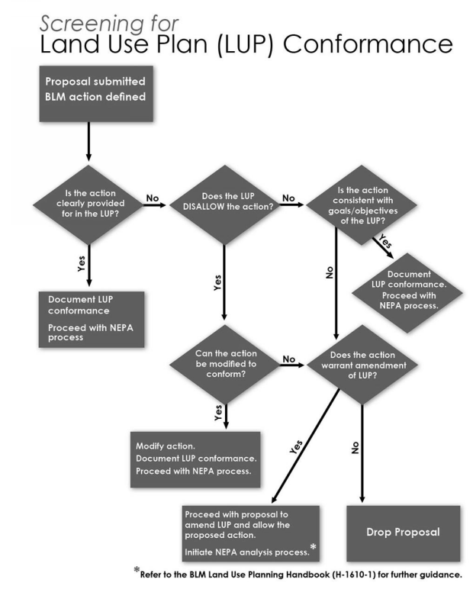
And it begins…
Proposal for action
Agency or external submission
Conformance review

Slide 10
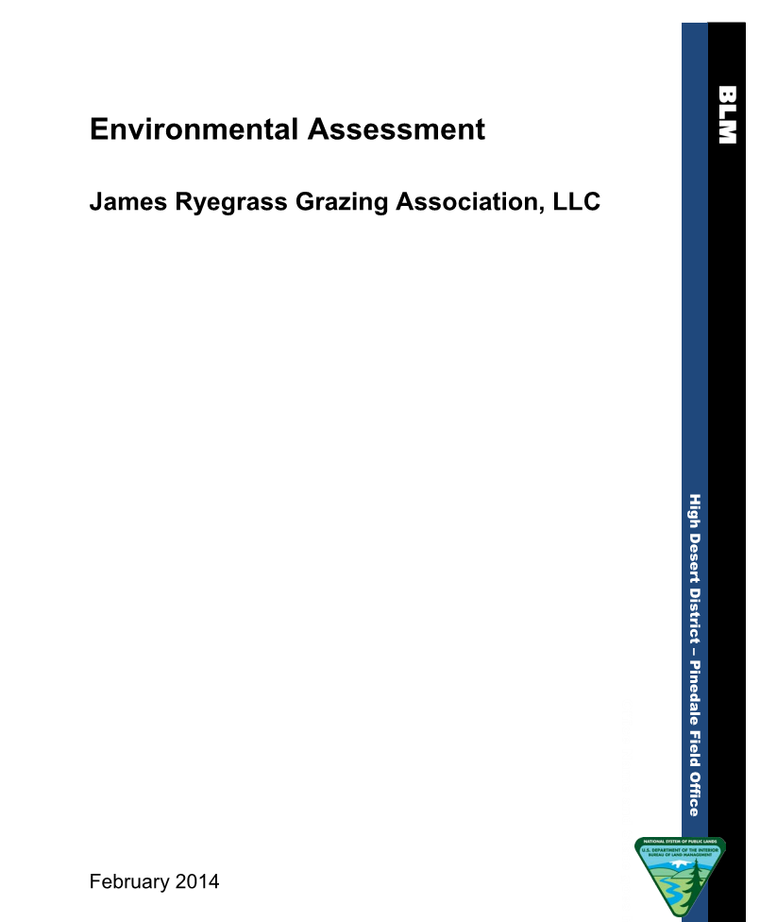
Outline of the Process
Identify the purpose and need for action, and describe the proposed action to the extent known
Scoping
Identify issues for analysis (including those from S&G)
Refine proposed action
Develop alternatives to the proposed action
Eliminate alternatives that do not require detailed analysis
Gather data and analyze the reasonable alternatives
Describe the environmental effects of the alternatives
Identify mitigation measures
Implement and monitor

Slide 11
Purpose & Need Statement
Purpose: provide the opportunity for continued livestock grazing
Need: Move the allotment toward achievement of the Fundamentals of Rangeland Health; to act on the BLMs responsibility under FLPMA and the Taylor Grazing Act to provide orderly use of the rangeland resources, where appropriate; to correct deficiencies in the current terms and conditions of the permit; and work toward achievement of the following objectives…
DOI-BLM-WY-100-2014-6-EA. James Ryegrass Grazing Association, LLC Environmental Assessment

Slide 12
Scoping
“There shall be an early and open process for determining the scope of issues to be addressed and for identifying the significant issues related to a proposed action. This process shall be termed scoping.” 40 CFR § 1501.7
“Scoping shall be carried out in accordance with the requirements of 40 CFR 1501.7. Because the nature and complexity of a proposed action determine the scope and intensity of analysis, no single scoping technique is required or prescribed.” 36 CFR § 220.4(e)(2)
External scoping is optional for BLM EAs

Slide 13
Issue identification
Supplemental Authorities | Not Present | Present Not Affected | Present Affected
Air Quality |  | X
Areas of Critical Environmental Concern (ACECs) | X
Cultural Resources |  |  | X
Environmental Justice | X
Floodplains | X
Historic Trails | X
Invasive, Nonnative Species |  | X
Migratory Birds |  |  | X
Native American Religious Concerns | X
Prime or Unique Farmlands | X
Threatened & Endangered Species | X
Wastes, Hazardous or Solid | X
Water Quality (Surface and Ground) |  | X
Wetlands and Riparian Zones | X
Wild and Scenic Rivers | X
Wilderness | X
Additional Affected Resources | Not Present | Present Not Affected | Present Affected
Lands and Realty | X
Noise |  |  | X
Paleontology | X
Rangeland Management |  |  | X
Recreation |  | X
Soils |  |  | X
Special Status Species |  |  | X
Transportation |  | X
Vegetation |  |  | X
Visual Resources |  | X
Wild Horses and Burros | X
Wildlife |  |  | X
Not a position statement
Includes establishment of the IDT
Highly variable by field office
“Most important, NEPA documents must concentrate on the issues that are truly significant to the action in question, rather than amassing needless detail”
40 CFR 1500.1(b)

Slide 14
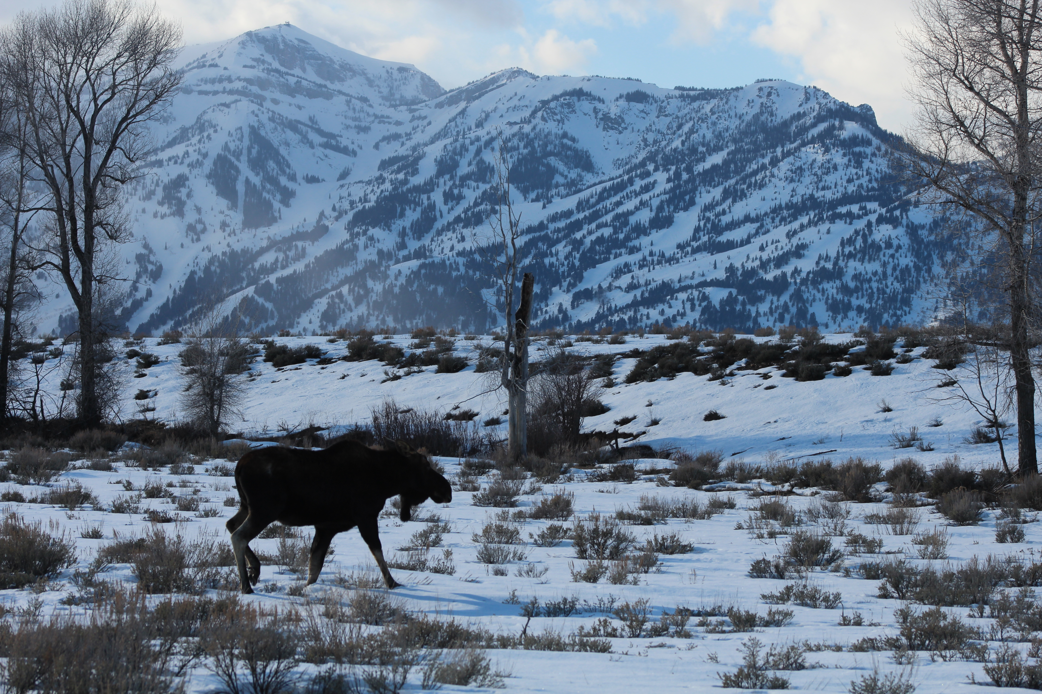
Issue example
Wildlife
Wildlife is a resource, not an issue
Concern over how wildlife may be affected by the proposal is the issue
Appropriate phrasing of an Issue: What would the effect be of livestock grazing on greater sage-grouse nesting habitat?
Appropriate phrasing of an Issue: What impact will winter wildlife use have on a reseeding project?

Slide 15
Finalize the Proposed Action
Who
Federal agency making the decision
What
Proposed activity or activities
When
Timeframe for implementation and completion
Where
Location of the proposed action
How
Means by which proposal would be implemented
“Why” is covered in the Purpose and Need statement

Slide 16
Identification of connected actions
Actions that are closely related and should be discussed
Automatically trigger other actions that may require an EIS
Cannot or will not proceed unless other actions are taken previously or simultaneously
Actions are interdependent parts of a larger action and depend on the larger action for their justification
Requires analysis of the direct, indirect, and cumulative effects of all actions
Direct, Indirect and Cumulative Actions

Slide 17
Cumulative actions
Effect
Effect
Effect
Reasonable and Foreseeable Actions
Federal and non-federal actions
Effect
Effect
Effect
Effect
Effect

Slide 18
Developing alternatives
“Study, develop, and describe appropriate alternatives to recommended courses of action in any proposal that involves unresolved conflicts concerning alternative uses of available resources…” (NEPA Section 102(2)(e))
“Reasonable alternatives include those that are practical or feasible from the technical and economic standpoint and using common sense, rather than simply desirable from the standpoint of the applicant.” (CEQ FAQ#2a)
“Reasonable” refers back to the relationship between the alternative and the purpose and need statements

Slide 19
Types of alternatives
No Action
For land use planning actions (i.e., RMP revisions) it is to continue to implement the land use plan as written.
For internally generated implementation actions it is to not take the proposed action
For externally generated proposals it is to reject the proposal or deny the application.
EXCEPT FOR GRAZING PERMITS! Then the no action is to issue a new permit with the same terms and conditions as the expiring permit. The No Action alternative must only analyze what is reasonable and foreseeable if the application is denied
Alternatives considered but eliminated from detailed analysis
Ineffective, technically or economically infeasible, inconsistent with management objectives, speculative, similar to an alternative that is being analyzed
Write these down!!

Slide 20
Affected environment
Affected environment succinctly describes the existing condition and trend of issue-related elements of the human environment that may be affected by implementing the proposed action or alternative
“Human environment” means biological, physical, social and economic elements of the environment
Creates the baseline for analysis
Includes present condition, past and ongoing actions, regulatory thresholds and stresses affecting the resources, and biological or physical thresholds

Slide 21
data
Data should be obtained that is “relevant to reasonably foreseeable significant adverse impacts….if it is essential to a reasoned choice among alternatives” if the overall cost of obtaining the data is not exorbitant
If the information relevant to reasonably foreseeable significant adverse impacts cannot be obtained because the overall costs are too high, or the means to obtain it are unknown, the following have to be included in the EA or EIS
A statement that such information is incomplete or unavailable
A statement of the relevance of the incomplete or unavailable information to evaluating reasonably foreseeable significant adverse impacts on the human environment
A summary of existing credible scientific evidence which is relevant
The agency’s evaluation of such impacts based on theory or generally accepted research methods (within the “rule of reason”)

Slide 22
Environmental effects (aka impacts)
Defining environmental effects
Ecological, aesthetic, historic, cultural, economic, social, or health – may be beneficial or detrimental
Analyze and disclose short- and long-term effects (positive and negative); includes direct, indirect and cumulative impacts
Analysis must take a “hard look” ( a reasoned analysis containing quantitative or detailed qualitative information)
Must include an explanation of methodologies use and analytical assumptions made

Slide 23
Environmental effects, cont’d
Direct Effects
Indirect Effects
Caused by the action and occur at the same time and place (40 CFR 1508.8(a)
Caused by the action and are later in time or farther removed in distance, but are still reasonably foreseeable. Indirect effects may include growth inducing effects and other effects related to induced changes in the pattern of land use, population density, or growth rate, and related effects on water and air and other natural systems, including ecosystems (40 CFR 1508.8(b))

Slide 24
Cumulative effects
“…the impact on the environment which results from the incremental impact of the action when added to other past, present, and reasonably foreseeable future actions regardless of what agency (Federal or non-Federal) or person undertakes such actions” 40 CFR 1508.7
Determine which issues identified for analysis may involve a cumulative effect with other past, present or reasonably foreseeable future actions
For each issue, identify the following:
Geographic scope of analysis area; timeframe for the analysis (long- and short-term); past, present and reasonably foreseeable future actions
Describe the existing condition (natural condition + past actions); effects of other present actions, effects of reasonably foreseeable action, effects of proposed action and each alternative, the interaction among the previous effects, the relationship of cumulative effects to any threshold

Slide 25
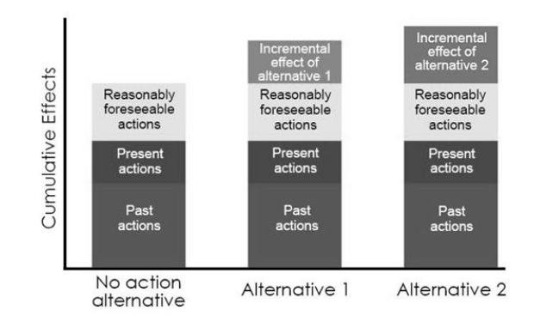
Cumulative effects example

Slide 26
Mitigation & residual effects
Mitigation measures are those that could reduce or avoid adverse impacts and have not been incorporated into the proposed action or alternative
Avoiding the impact altogether by taking an action or parts of an action
Minimizing impact by limiting the degree of magnitude of the action and its implementation
Rectifying the impact by repairing, rehabilitation, or restoring the affected environment
Reducing or eliminating the impact over time by preservation and maintenance operations during the life of the action
Compensating for the impact by replacing or providing substitute resources or environments
Residual effects are those that remain after mitigation

Slide 27
Public involvement
Agencies must “make diligent efforts to involve the public in preparing and implementing their NEPA procedures” 40 CFR 1506.6(a)
Public meetings are required when there may be substantial environmental controversy concerning the environmental effects of the proposed action, a substantial interest in holding the meeting, or a request for a meeting by another agency with jurisdiction over the action (40 CFR 1506.6(c))

Slide 28
Ea contents
Introduction
Purpose and need for action and decision to be made
Scoping and issues
Proposed action and alternatives
Conformance
Affected environment
Environmental effects
Tribes, individuals, organizations and agencies consulted
List of preparers

Slide 29
Determination of significance (aka FONSI)
If the selected alternative will have significant environmental effects, the analysis must transition to an Environmental Impact Statement.
If no significant environmental effects are identified, the FONSI is issued
FONSI = Finding of No Significant Impact
EA must be attached to or incorporated by reference to the FONSI
May be available for a 30-day review; if so, it is generally not signed until after the review
“scientific or public controversy over the effects of the proposal”
FONSI is signed before the issuance of the decision record
Not this guy…

Slide 30
Decision record
Decision (proposed action) cannot be implemented until the decision record is signed
Identifies the selected alternative and any limitations
References the FONSI
Summarizes public involvement
Explains the rationale for the decision
Describes protest and appeal opportunities

Slide 31
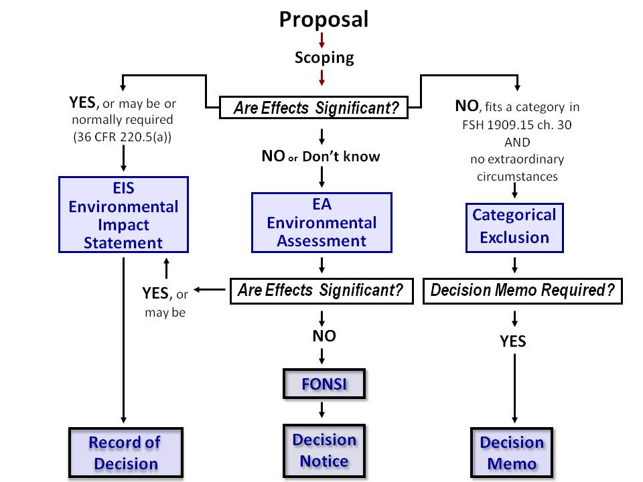
In review

Slide 32
Permit Renewal - BLM
BLM
Specialists (Range Con.) are the proponent and manage the process
Requires completion of the Standards & Guidelines determination
Follows NEPA
Appeal to an administrative law judge
15 days to Protest Draft
30 days to Appeal Decision
Can request a petition for stay
Show justification for relative harm, likelihood of appellant’s success on merits, likelihood of immediate and irreparable harm if stay is not granted, and whether the public interest favors granting the stay
Notes:
Appeal = challenges for IBLA or an ALJ. Protest goes to BLM Director

Slide 33
Permit Renewal - USFS
Forest Service
NEPA Coordinator manages the specialists and process
Follows NEPA
Appeal to Deciding Officer

Slide 34
FS administrative appeals
Administrative Appeals in the Bureau of Land Management and Forest Service. CRS. 2013.

Slide 35
You made it!
Questions?

